Slide 1
Analyzing COVID-19 Spread: Approach & Key Findings BY SQL
Kholod Sadek Mohammed
6/2024

Slide 2
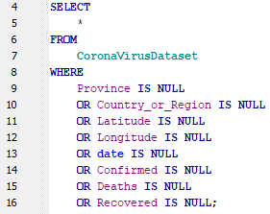
in Question 1 & 2
Write a code to check NULL values.
If NULL values are present, update them with zeros for all columns.
THERE IS NOT NULL VALUES IN THE DATASET
-- Check by IS NULL
& OR To be able to check in each column

Slide 3


in Question 3
check total number of rows
OUTPUT:
Check by count(*)

Slide 4


in Question 4
Check what is start_date and end_date.
OUTPUT:
Check by MIN & MAX in date column

Slide 5
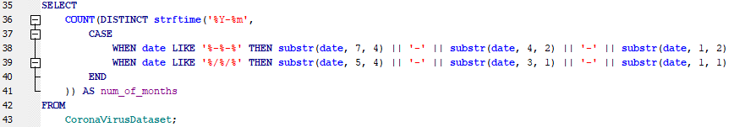

in Question 5
Number of month present in dataset.
Calculated by:
CASE WHEN ... THEN ... END => checks the format of the date column and normalizes it accordingly.
date LIKE '%-%-%’ => Checks if the date format is DD-MM-YYYY
date LIKE '%/%/%’ => Checks if the date format is D/M/YYYY
Substr => Extracts the year, month, and day from the DD-MM-YYYY format and constructs a normalized date string in the YYYY-MM-DD format.
strftime('%Y-%m', ...) => extracts the year and month from the normalized date string, producing a string in the format YYYY-MM.
OUTPUT:

Slide 6
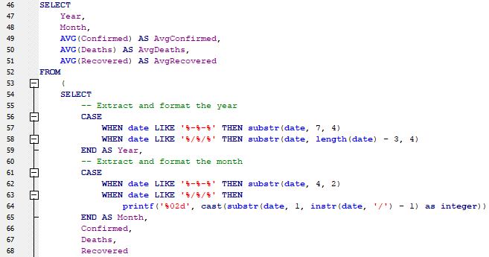
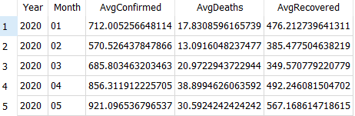

in Question 6
Find monthly average for confirmed, deaths, recovered
Calculated by AVG
OUTPUT:

Slide 7
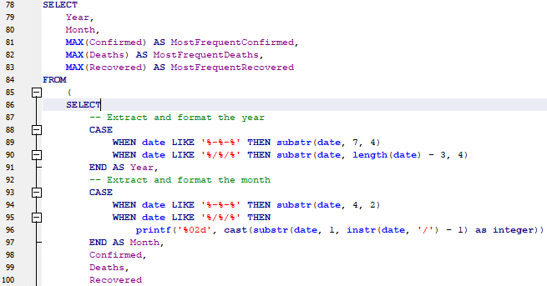
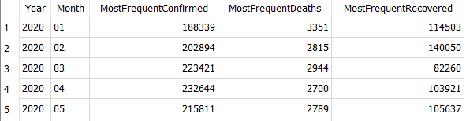

in Question 7
Find most frequent value for confirmed, deaths, recovered each month.
Calculated by MAX
OUTPUT:

Slide 8
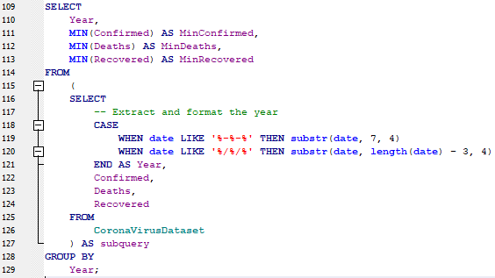

in Question 8
Find minimum values for confirmed, deaths, recovered per year.
Calculated by MIN
OUTPUT:

Slide 9


in Question 9
Find maximum values of confirmed, deaths, recovered per year.
Calculated by MAX
OUTPUT:

Slide 10
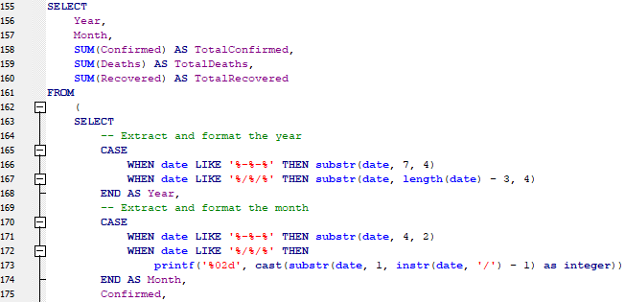
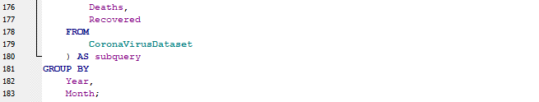
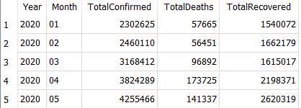
in Question 10
The total number of case of confirmed, deaths, recovered each month.
Calculated by SUM
OUTPUT:

Slide 11
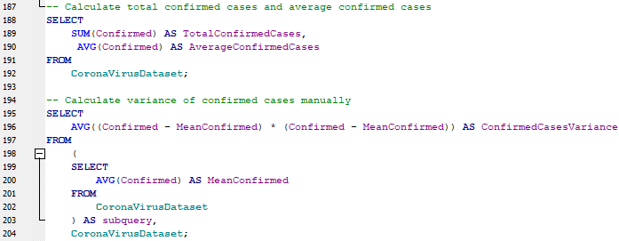

in Question 11
Check how corona virus spread out with respect to confirmed case. (E.g.: total confirmed cases, their average, variance & STDEV )
Calculate the total by SUM , the average by AVG , the variance by average of (confirmed – average of (confirmed ))*(confirmed – average
of (confirmed )) and the standard variance by exponentiating ( 0.5 * logarithmic (variance)
OUTPUT:

Slide 12
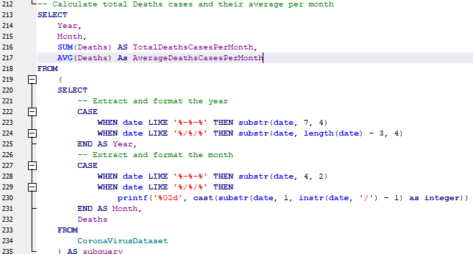
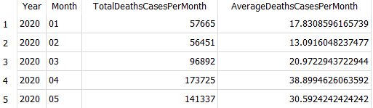
in Question 12
Check how corona virus spread out with respect to death case per month (E.g.: total confirmed cases, their average, variance & STDEV )
OUTPUT:

Slide 13
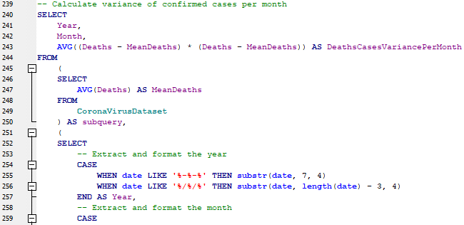
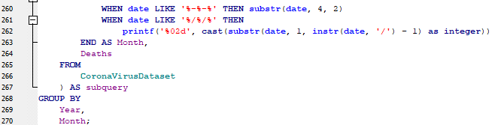
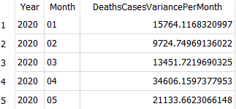
Cont. Question 12
OUTPUT:

Slide 14


Cont. Question 13
Check how corona virus spread out with respect to recovered case (E.g.: total confirmed cases, their average, variance & STDEV )
Will Repeat the same code in the Q11 just replace the column Deaths with Recovered column
OUTPUT:

Slide 15


Cont. Question 14
Find Country having highest number of the Confirmed case.
OUTPUT:
Calculated by MAX

Slide 16


Cont. Question 15
Find Country having lowest number of the death case.
OUTPUT:
Calculated by MIN

Slide 17
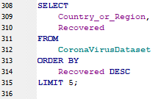
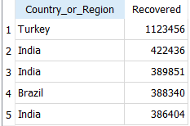
Cont. Question 16
Find top 5 countries having highest recovered case.
OUTPUT:
Calculated by ORDER BY and DESC to calculate the highest and used LIMIT To select the first 5 only

Slide 18
Thank you
Kholod Sadek

